Slide 1
Advanced Concepts in Acid – Base Chemistry
for 2nd and 3rd Year Organic and Biochemistry Students
David Morgan
NDSU Department of Chemistry and Biochemistry
4:00 pm, October 26th, 2023
Sugihara 252

Slide 2
Review: Brønsted – Lowry Definitions of Acids and Bases
According to the Brønsted – Lowry definitions:
An acid is a species that increases the proton concentration of a solution.
A base is a species that increases the hydroxide concentration of a solution.
Examples of Brønsted – Lowry acids:
HCl:
Acetic acid:
H₂O

Slide 3
Review: Brønsted – Lowry Definitions of Acids and Bases
According to the Brønsted – Lowry definitions:
An acid is a species that increases the proton concentration of a solution.
A base is a species that increases the hydroxide concentration of a solution.
Examples of Brønsted – Lowry bases:
NaOH:
Ammonia:
H₂O
H₂O

Slide 4
Review: Strong and Weak Acids and Bases
Strong acids and bases ‘dissociate fully’ in aqueous solution. The reaction ‘goes to completion.’
HCl:
NaOH:
Notice the arrows.
H₂O
H₂O

Slide 5
Review: Strong and Weak Acids and Bases
In contrast, the dissociation of weak acids and bases are equilibrium processes, and solutions contain both dissociated and non-dissociated forms.
Acetic acid:
Ammonia:
H₂O

Slide 6
Review: Conjugate Acid / Base Pairs
The dissociation of a weak acid results in the liberation of a proton and a conjugate base.
The acetate anion is the conjugate base of acetic acid:
The hydrolysis of water by a weak base results in the liberation of an hydroxide anion and a conjugate acid.
The conjugate base of a weak acid is a weak base:
$K_{A}=$
$K_{B}=\frac{\left[{CH}_{3}COOH\right]\left[{OH}^{−}\right]}{\left[{{CH}_{3}COO}^{−}\right]}$

Slide 7
Review: Water is Both a Weak Acid and a Weak Base
Therefore:
][]
From which, of course, we get the pH (and pOH) scales.

Slide 8
Review: The Reaction of a Weak Acid with a Base
Generates a Salt and Water

Slide 9
Review: The Reaction of a Weak Acid with a Base
Generates a Salt and Water
Now:
What if instead of carrying out this reaction quantitatively, it were instead carried out only partially?
That is, instead of reacting an equimolar amount of base with the weak acid, only a fractional amount, say half the molar amount, of the base were added?

Slide 10
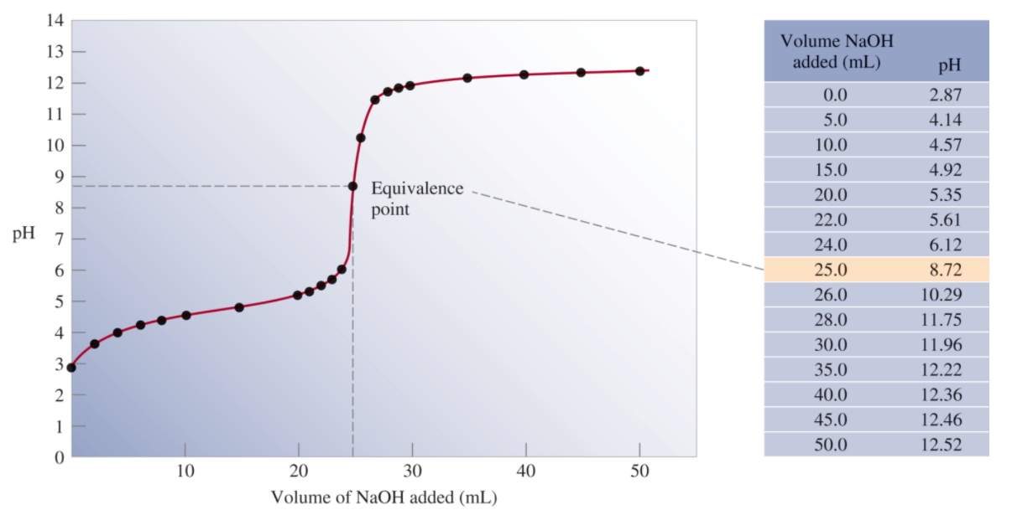
Titration of a Weak Acid by a Strong Base
Note: the gradual change in pH as a function of base added.
At each point in the titration (before the equivalence point) the solution consists of a mixture of acid and conjugate base forms. This is a buffer.

Slide 11
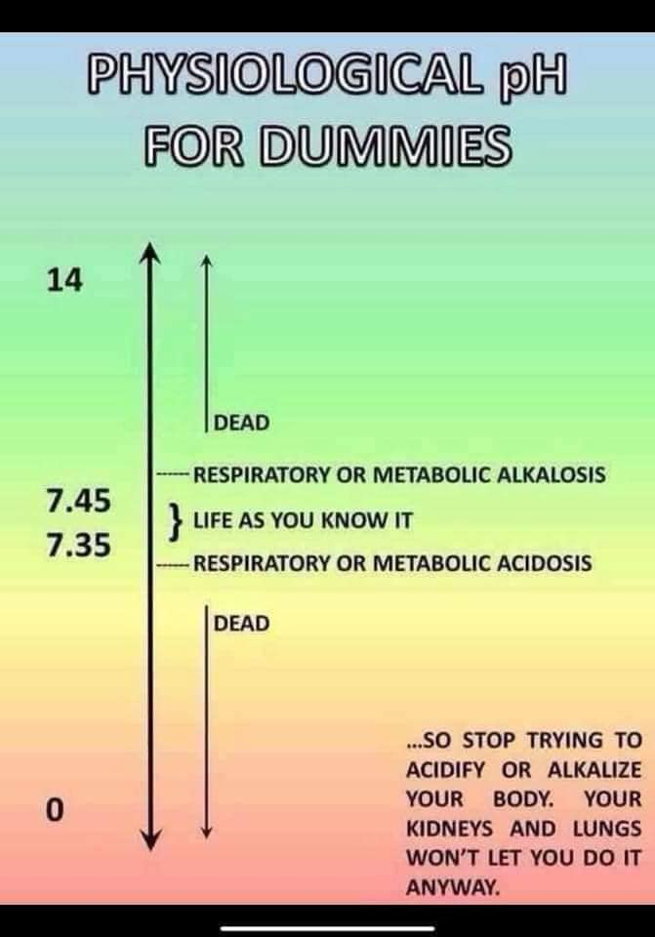
Buffers: Solutions Which are Mixtures of Acid (or base) and Conjugate Base (or acid) Forms
Buffers resist changes in pH.
Buffers are essential.
For health and disease.
Example: the blood is a carbonic acid / bicarbonate buffer system which maintains pH in the vicinity of 7.35 – 7.45.

Slide 12
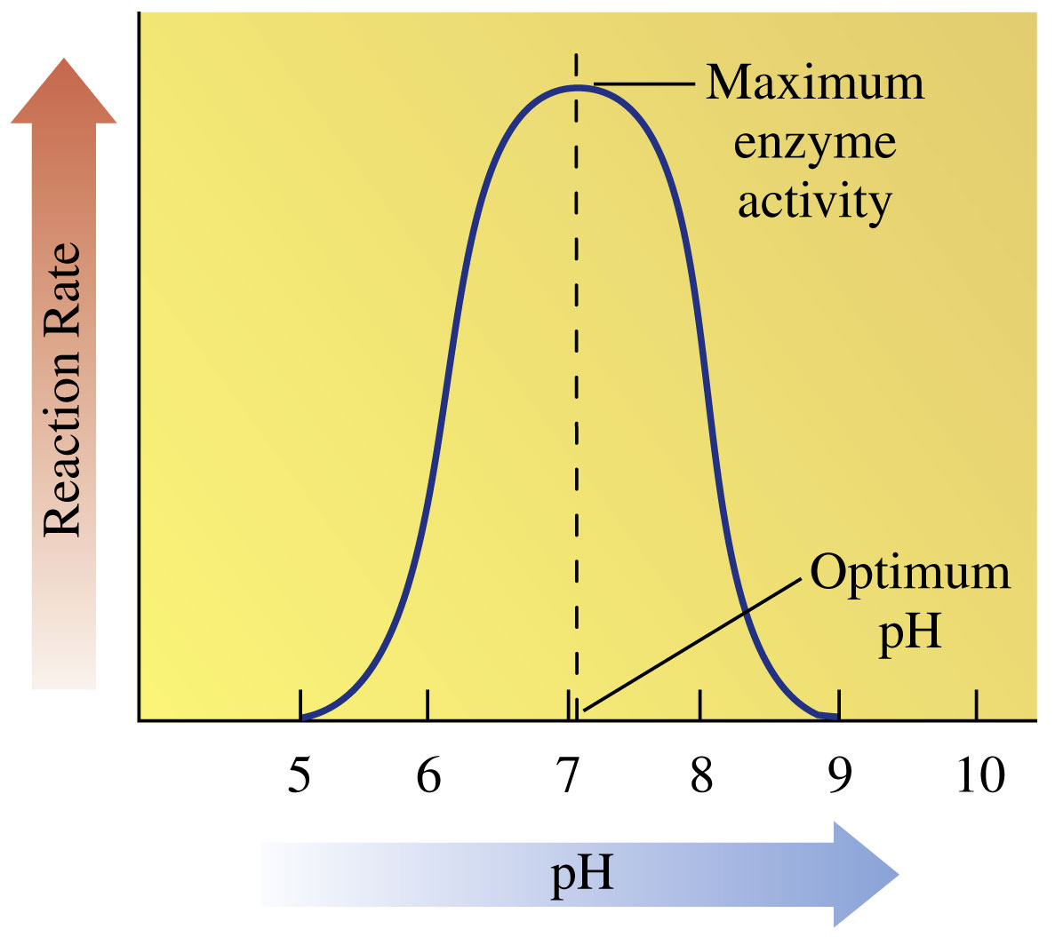
Why Are Buffers Important?
pH Affects Enzymatic Activity:
Much of enzymatic catalysis involves weak acid / weak base chemistry.
In other words, proton transfers play a big role in enzymatic catalysis.
Therefore, pH dramatically affects enzymatic activity.
Almost all enzymes only carry out their reactions in a narrow range of pH.
Can anyone think of another
reason it is preferable to study
proteins in buffered solutions?
© 2018 Pearson Education, Inc.
Notes:
Figure 16-14 Enzymes are most active at their optimum pH. At a higher or lower pH, denaturation of the enzyme causes a loss of catalytic activity.

Slide 13
The Henderson – Hasselbalch Equation
An Equation relating pH and concentrations of Acids and Conjugate Bases
Solving for [H⁺]:
Taking negative logarithms of both sides and rearranging:

Slide 14
Lewis Acidity and Basicity:
More General Definitions of the Concepts
Recalling the Bronsted definition:
What is this?
(Literally.)

Slide 15
Lewis Acidity and Basicity:
More General Definitions of the Concepts
Recalling the Bronsted definition:
What is this?
It is literally a proton.
What is a (literal) proton missing
that all other at atoms have?
Obviously – one or more electrons.
A Lewis acid is a species that is electron deficient:
or which is more usually described as “an electron pair acceptor.”
Conversely, a Lewis Base is a species that is electron rich: or which is more usually described “as an electron pair donor.”

Slide 16
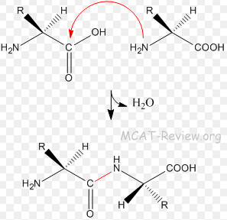
Why Lewis Acids and Bases
“All organic chemistry can be thought of as acid-base chemistry.”
David Lynn
(My graduate school advisor)
Generic amino acids:
Lewis Acid, also:
an electrophile.
Lewis Base, also:
a nucleophile.

Slide 17
DMM Switch to ELMO / WB

Slide 18
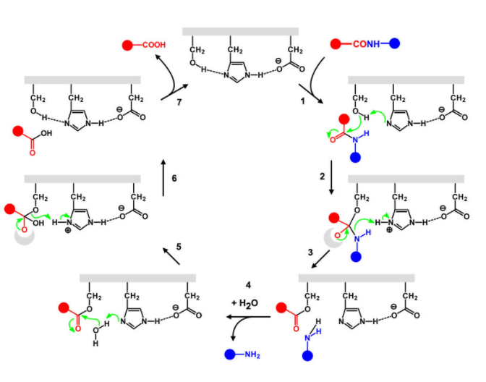
Serine Proteases Exhibit a Catalytic Triad
Mechanism of Peptide Bond Cleavage
Wieczorek, Rafal & Adamala, Katarzyna & Gasperi, Tecla & Polticelli, Fabio & Stano, Pasquale. (2017). Small and Random Peptides:
An Unexplored Reservoir of Potentially Functional Primitive Organocatalysts. The Case of Seryl-Histidine. Life. 7. 10.3390/life7020019.

